Slide 1


PROGRESS LOG
Edited by
Loek Ehren
Mike Schatorjé
Simone Francesconi
Herm Lecluse
Rick van Osch

Slide 2
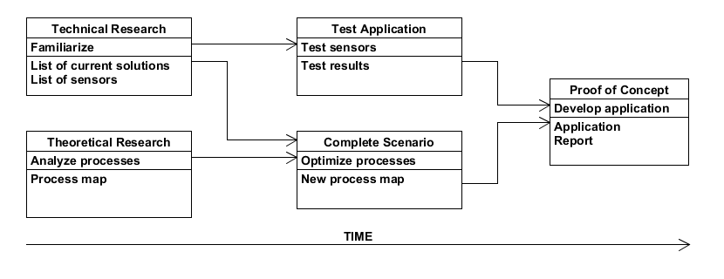


The project

Slide 3


What did we want to achieve?
Continue with report
Evaluate process map
Continue with the exhibition Presentation
Prototype physical building

Slide 4



How did we do it?
Divided work
Gathering more information from Leo Jacobs
Cut and assemble the prototype

Slide 5

What were the results?
Secondary process of the GCS and its cost
Implenting costs of our system
A physical Box

Slide 6
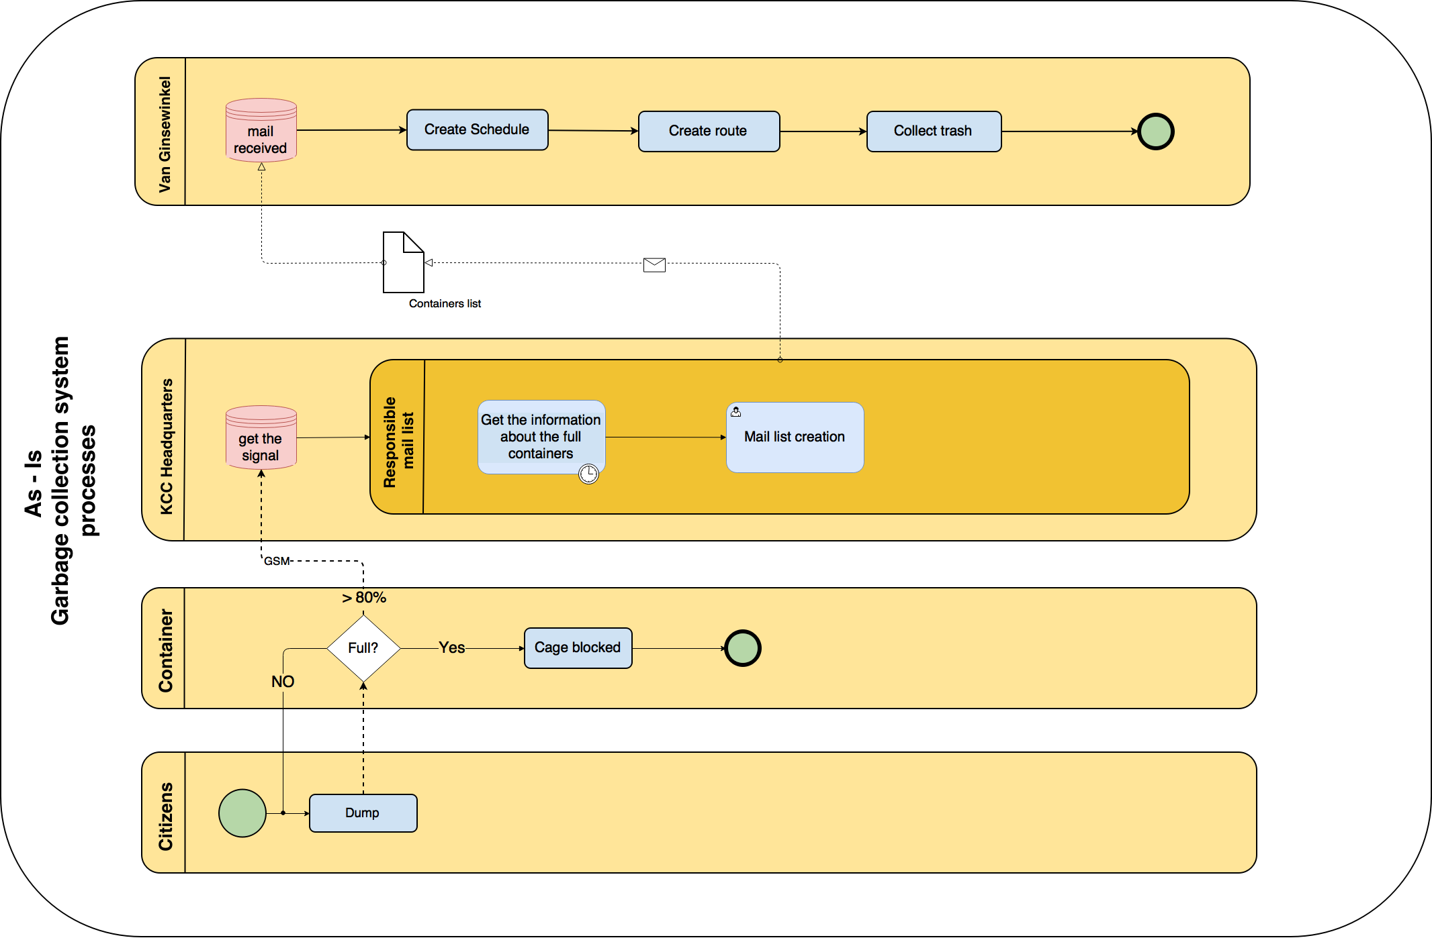

Slide 7
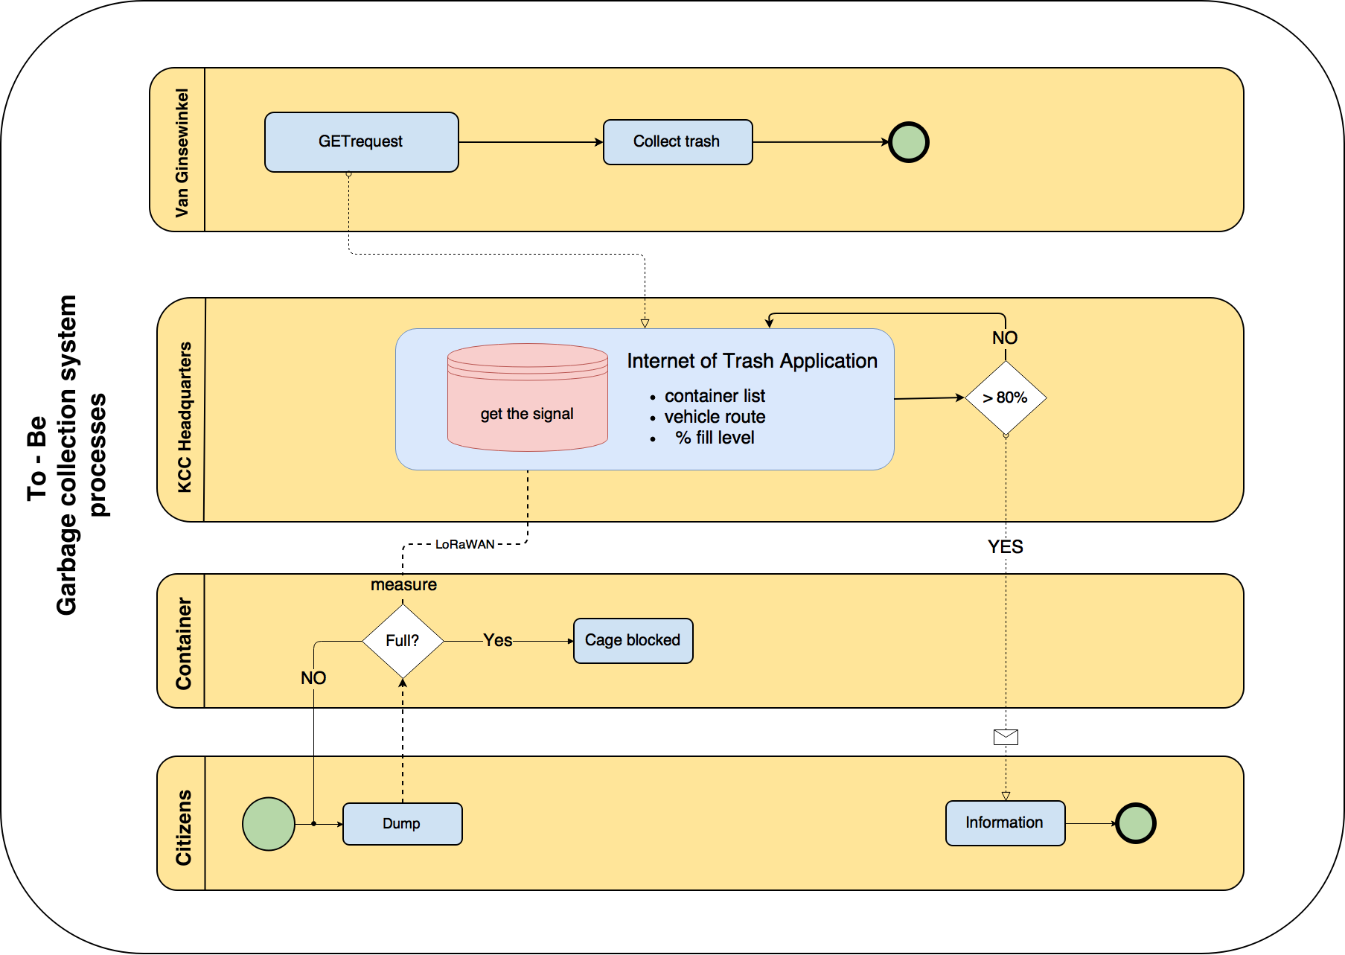

Slide 8
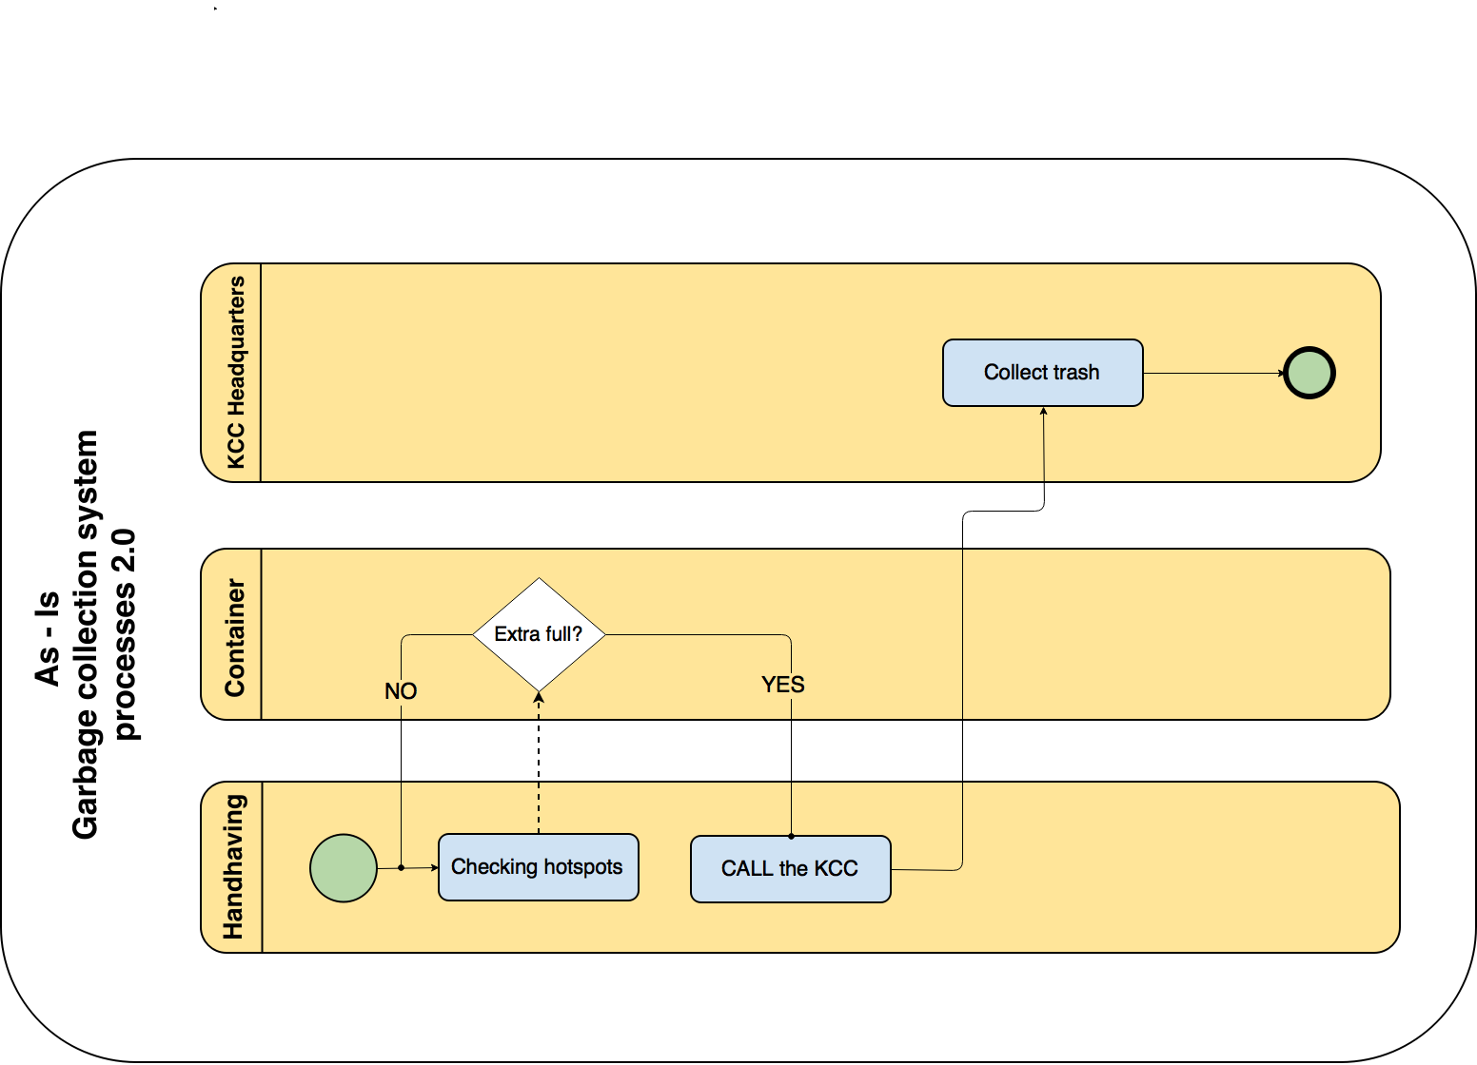

Slide 9
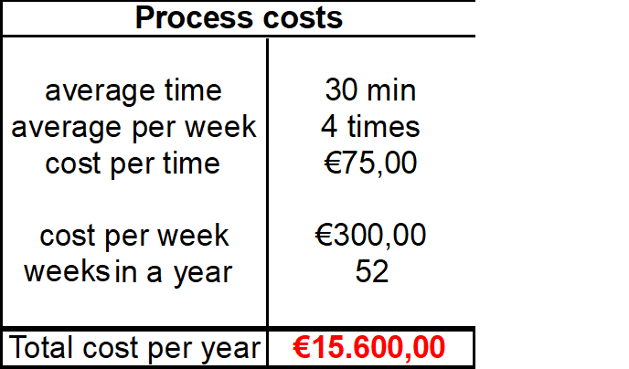
Process cost
Truck costs (i.e. fuel)
Truck driver
‘Handhaving’

Slide 10
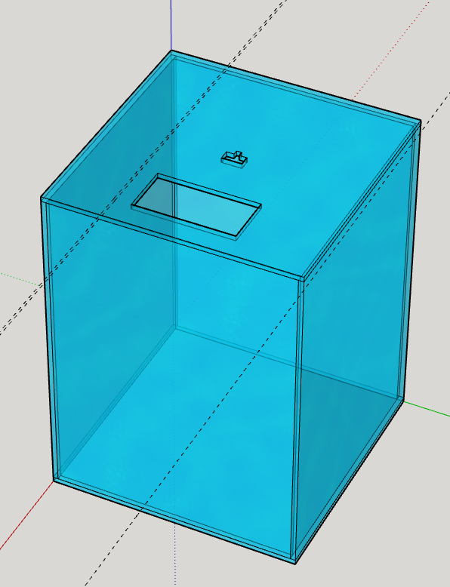
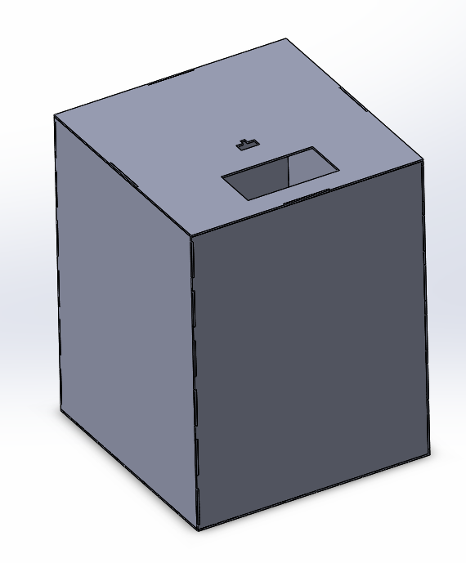
Results

Slide 11
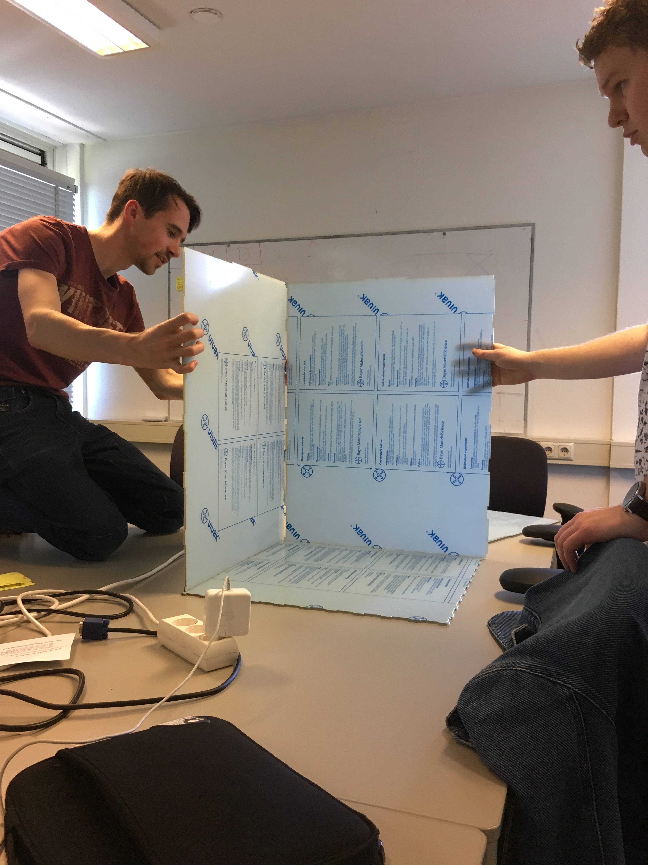
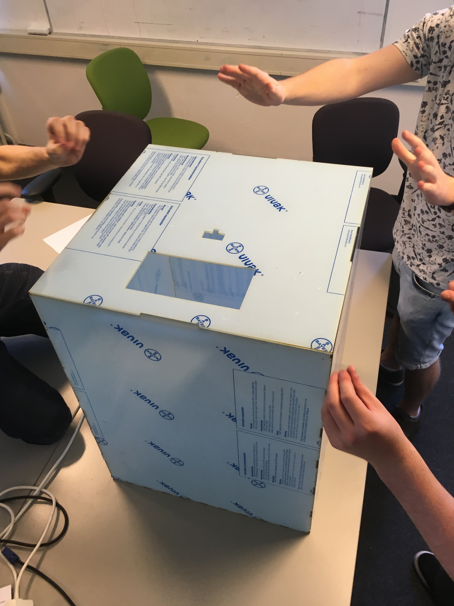
Results

Slide 12
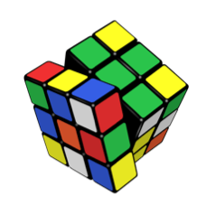
What were the problems?
A new process to analyze
Laser cutter rather busy
Difficult to fix all the faces of the prototype

Slide 13
What were the lessons learned?
Very important to pay attention when we have to define all the existing processes
Laser cutting requires expertise

Slide 14
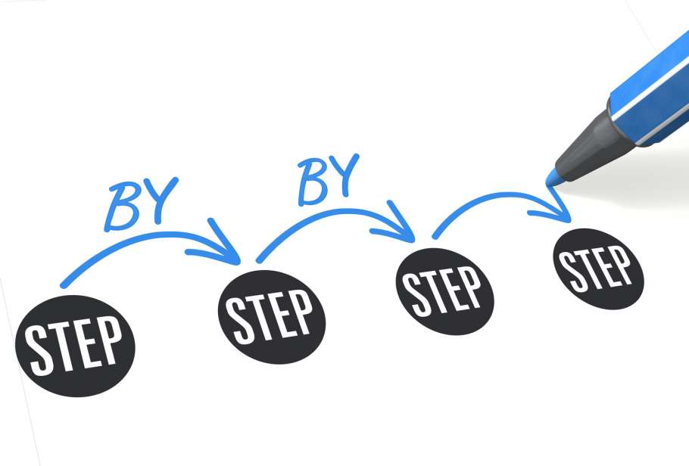
What do we want to achieve?
Cost analysis and differences among the 2 systems
Implement hardware + software in the box
Create a small case for all the electronics
Button functionality

Slide 15
Any Question?
Thanks for your attention!

